Slide 1
Sorting Algorithms
Goutam Lal

Slide 2
Sub Topic
Why do we need sorting ?
  What is sorting ?
  Classification of Algorithm.
  Application of sorting.
Sorting Algorithm
  Bubble Sort.
  Insertion Sort.
  Selection Sort.
  Comparison between these three sort.

Slide 3
Sorting
What is Sorting?
Sorting is way to organize the data in ascending order or descending order.
Classification :-
There are several sorting algorithm. Based on certain things we will choose a particular algorithm.
The things are,
1)Time complexity :- Time complexity of an algorithm is nothing but the time taken to solve the algorithm.
2)Stability :- A sorting algorithm is said to stable when the order of the element does not change if two element with equal key comes in the data.
3)In-place Sorting :- A sorting is said to be in-place when there is no extra space required to sort the data.
4)Internal Sorting :- Internal sorting are type of sorting which is used when the entire collection of data is small enough that sorting can take place within main memory. There is no need for secondary memory for execution of sorting program.
5)External Sorting :- External sorting are type of sorting algorithm when the entire collection of data is not small enough to sort it in RAM then at that time has to placed in secondary memory.

Slide 4
Why do we need sorting
Application of sorting:-
Searching :- If the data is already sorted then we can able to search a particular data in very effective time,like we have used Binary search.
Selection :- To find the kth largest element in an array,we can also use the sorting algorithm.
Element Uniqueness :- To find the unique element we can also use the sorting algorithm to get the very effective time
Closest Pair :- If number is already sorted then the closest pair will be live always next to each other.

Slide 5
Bubble Sort
Bubble sort is a simple, inefficient sorting algorithm that is used to sort a list. It is generally one of the first algorithm that is taught to us to develop concept regarding sorting.
The name “Bubble” came because during each pass element tend to move into the correct order like bubbles rising to the surface.
Bubble sort is stable because the order of the elements with equal key does not change.
Bubble sort is in-place sorting algorithm because it does not require any extra space to sort the algorithm. i.e. O(1).
Bubble sort is internal sorting algorithm.

Slide 6
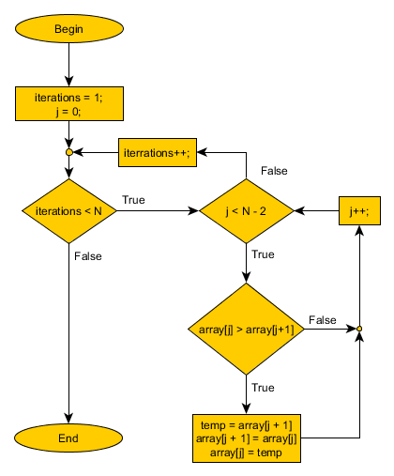
Flowchart of Bubble Sort

Slide 7
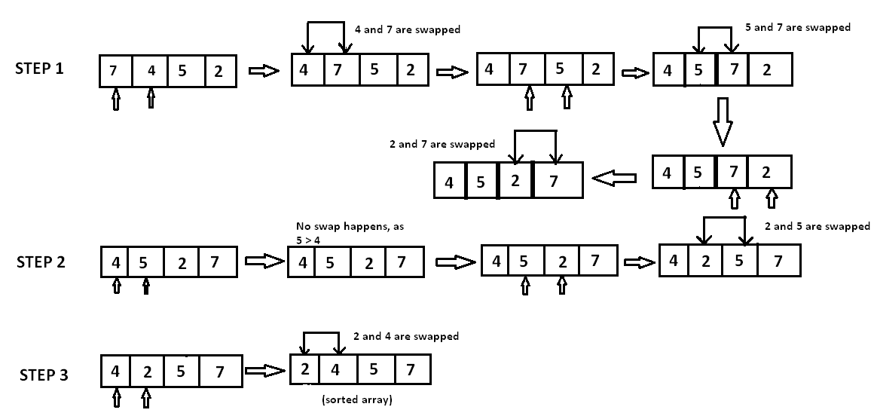
Working of Bubble Sort

Slide 8
How to optimize Bubble sort
Bubble_Sort(A)
1.for i = 0 to n Here: n = size of the array
2. flag = 0
3. for j = 0 to n – i -1
4. if A[j] > A[j + 1]
5. swap(A[j], A[j+1])
6. flag = 1
7. if flag == 0
8. break

Slide 9
Time Complexity Analysis of Bubble Sort
Best Case
  The best case occur when the array is already sorted. In that case only 'n' comparison will be required and no swapping will be happen in that case. So the sorting will happen only one iteration of 'n' elements. Then time complexity will be O(n).
Worst Case
  the Worst case occur when array is reversely sorted. This means that first iteration will be happen for 'n-1' times, then 2nd iteration will happen for 'n-2' times,this will repeated until we reach to the 'nth' iteration will happen for '1' times So the time complexity is
  Big-oh = (n-1) + (n-2) + (n-3) + (n-4) + …........... + 3 + 2 + 1
  = n(n - 1)/2
  = (n² - n)/2
  = O(n²)

Slide 10
Selection sort
Selection sort is one of the sorting algorithm which is useful for sorting small amount of data. Selection sort is notable for its programing simplicity.
This algorithm first find the smallest element then we swap it with the first element,then it will find the second smallest one then it will swap with the second position, and it will keep on doing this until the entire array is sorted.
Selection sort is not stable.
Selection sort is in-place sorting algorithm because it does not require any extra space. i.e. O(1) .
Selection Sort is internal sorting.

Slide 11
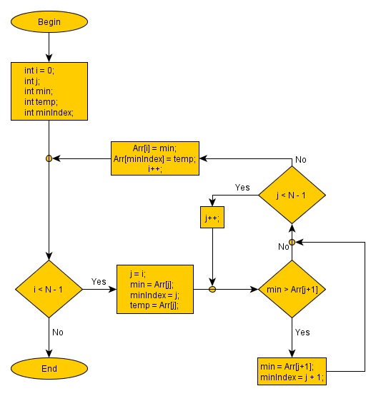
Flowchart of Selection Sort

Slide 12
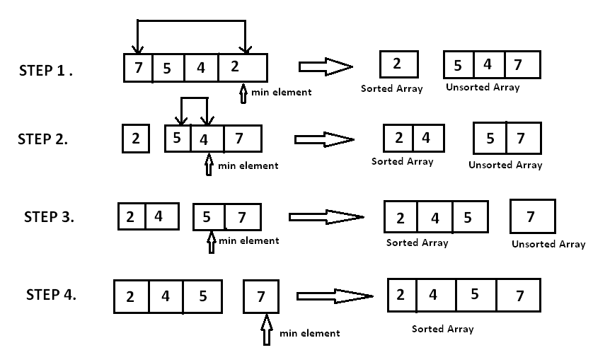
Working of selection Sort

Slide 13
Time Complexity Analysis of Selection Sort
Worst Case Suppose we have n element, in the first pass we have to scan all the element to find the minimum element and we have place it to the first position and in the second pass we have 'n-1' element again we to place in the second position,this will happen when the entire array is sorted.
Big-oh = (n -1) + (n-2) + (n-3) + …........... + 3 + 2 + 1
  = n(n - 1)/2
  = (n² +n)/2
  = O(n²)
Best case
Best case will be same as the worst case for selection sort i.e O(n²)

Slide 14
Insertion Sort
Insertion sort is one the efficient sorting for small input size of data. It works like same as we had played playing card.
During every iteration of insertion sort,it removes one element from the data and placed it into the correct position where it belong to the sorted list. It repeats the same procedure until the entire element get sorted.
Insertion sort is in-place sorting algorithm because it does not require any extra space to sort the data. i.e. O(1)
Insertion sort is internal sorting algorithm.
Insertion sort is stable.

Slide 15
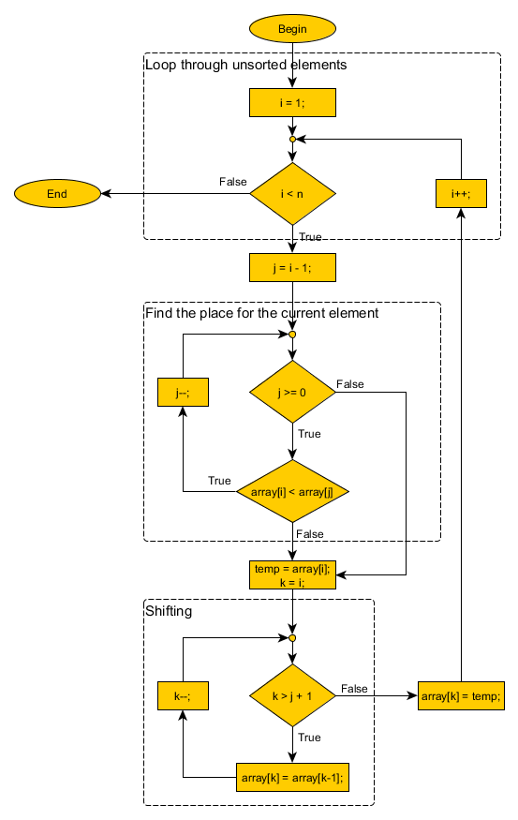
Flowchart of Insertion sort

Slide 16
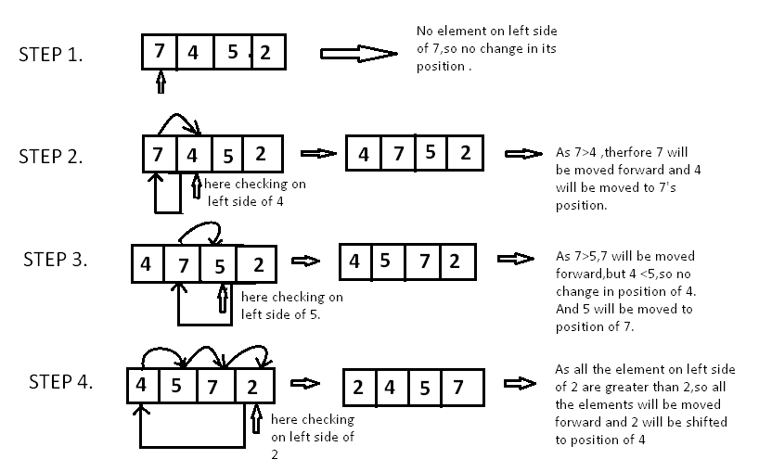
Working of Insertion Sort

Slide 17
Time Complexity Analysis of Insertion Sort
Best Case
Best case is occurred when elements are already sorted. In that case during the first iteration that is executed 'n' times the entire array get sorted. Big-oh = O(n).
Worst Case
Worst case is happened when the entire elements are reversely sorted. To insert the last element, we need at most comparisons 'n-1' and at most 'n-1' swaps. To insert the second to last element, we need at most 'n-2' comparisons and at most 'n-2' swaps, and so on.
Big-oh = 1 + 2 + 3 + …......+ (n-2) + (n-1)
= n(n + 1)/2
= O(n²)

Slide 18
Comparison between These Three Sort
Basis for comparision | Bubble Sort | Selection Sort | Insertion Sort
Time complexity | Best -O(n) Worst -O(n²) | Best-O(n²) Worst-O(n²) | Best-O(n²) Worst-O(n²)
Space Complexity | O(1) In-place | O(1) In-Place | O(1) In-place
Stability | Stable | Unstable | Stable
Adaptive or Non Adaptive | Adaptive | Non-Adaptive | Adaptive
Internal Sort or External Sort | Internal sort | Internal Sort | Internal Sort

Slide 19
References
Introduction to Algorithm(Thomas H. Corman)
The Algorithm Design Manual(Steven S. Skiena)
https://www.geeksforgeeks.org/sorting-algorithms/
https://brilliant.org/wiki/insertion/

